Slide 1
Discrete Mathematics
What is Path?
Graph & Path– Lesson 9
August 10, 2016

Slide 2
Review from previous class
Graphs are discrete structures consisting of vertices and edges that connect these vertices.
A graph G = (V ,E) consists of V , a nonempty set of vertices (or nodes) and E, a set of edges.

Slide 3
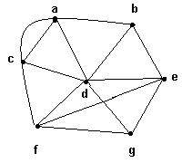
Degree of a vertex
The degree of a vertex v, denoted by deg(v), is the number of edges incident on v
Example:
deg(a) = 4, deg(b) = 3,
deg(c) = 4, deg(d) = 6,
deg(e) = 4, deg(f) = 4,
deg(g) = 3.

Slide 4
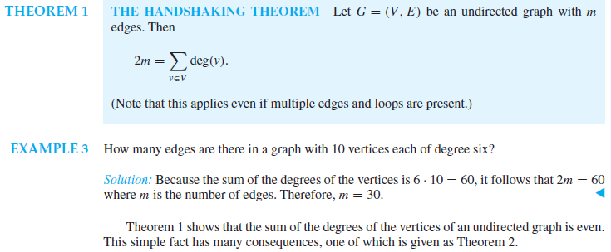
The Handshaking Theorem 1

Slide 5
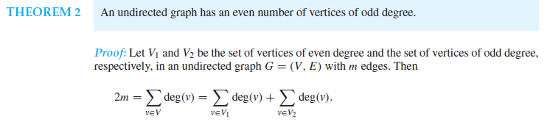
The Handshaking Theorem 2

Slide 6
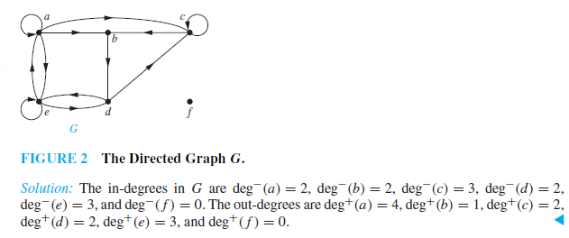
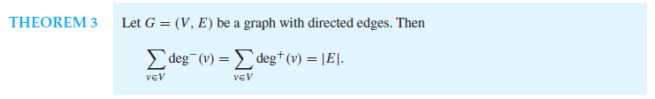
The Handshaking Theorem 3

Slide 7
Path?
Informally, a path is a sequence of edges that begins at a vertex of a graph and travels from vertex to vertex along edges of the graph.

Slide 8
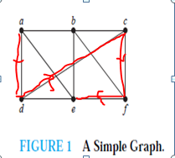
Example
In the simple graph shown in Figure 1, a, d, c, f , e is a simple path of length 4, because {a, d},{d, c}, {c, f }, and {f, e} are all edges. However, d, e, c, a is not a path, because {e, c} is not an edge.
Note that b, c, f , e, b is a circuit of length 4 because {b, c}, {c, f }, {f, e}, and {e, b} are edges, and this path begins and ends at b.
The path a, b, e, d, a, b, which is of length 5, is not simple because it contains the edge {a, b} twice.

Slide 9
Euler circuit
1.Can we travel along the edges of a graph starting at a vertex and returning to it by traversing each edge of the graph exactly once?
This question, which asks whether a graph has an Euler circuit.

Slide 10
Definition 1
An Euler circuit in a graph G is a simple circuit containing every edge of G.
An Euler path in G is a simple path containing every edge of G.

Slide 11
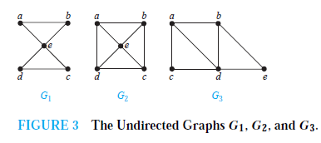
Example1
The graph G1 has an Euler circuit, for example, a, e, c, d, e, b, a.
Neither of the graphs G2 or G3 has an Euler circuit (the reader should verify this).
However, G3 has an Euler path, namely, a, c, d, e, b, d, a, b. G2 does not have an Euler path

Slide 12
Theorem 2
A connected multigraph has an Euler path but not an Euler circuit if and only if it has exactly two vertices of odd degree.

Slide 13
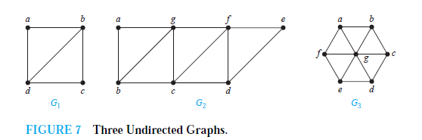
Example2
G1 contains exactly two vertices of odd degree, namely, b and d. Hence, it has an Euler path that must have b and d as its endpoints. One such Euler path is d, a, b, c, d, b.
Similarly,G2 has exactly two vertices of odd degree, namely, b and d. So it has an Euler path that must have b and d as endpoints. One such Euler path is b, a, g, f, e, d, c, g, b, c, f, d.
G3 has no Euler path because it has six vertices of odd degree.

Slide 14
Hamilton circuit
Similarly, can we travel along the edges of a graph starting at a vertex and returning to it while visiting each vertex of the graph exactly once?
This question, which asks whether a graph has a Hamilton circuit

Slide 15
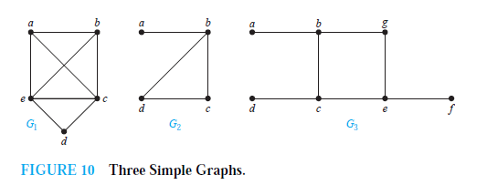
Which of the simple graphs in Figure 10 have a Hamilton circuit or, if not, a Hamilton path?

Slide 16
Solution
G1 has a Hamilton circuit: a, b, c, d, e, a.
There is no Hamilton circuit in G2 (this can be seen by noting that any circuit containing every vertex must contain the edge {a, b} twice),but G2 does have a Hamilton path, namely, a, b, c, d.
G3 has neither a Hamilton circuit nor a Hamilton path, because any path containing all vertices must contain one of the edges {a, b},{e, f }, and {c, d} more than once.

